Slide 1
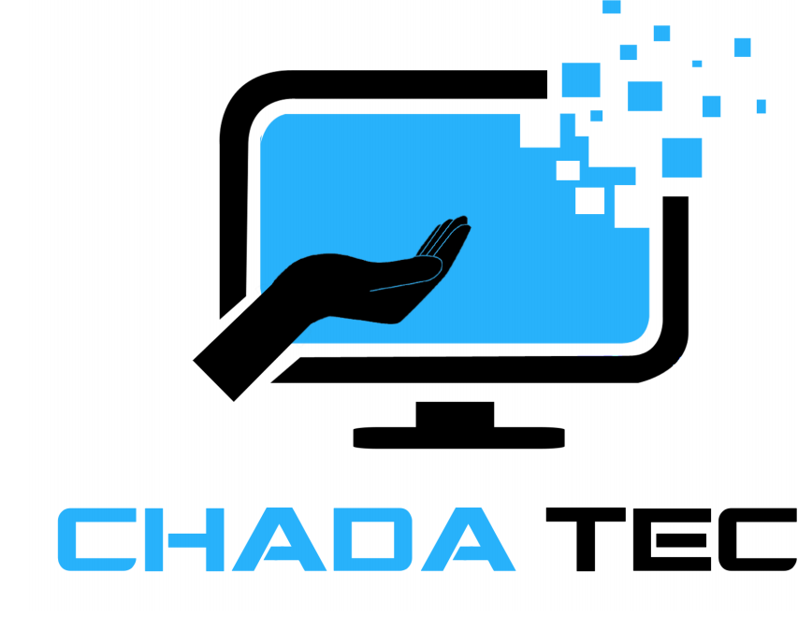
Transitioning to Agile: Lessons from the SNHU Travel Project
Tatiana E. Epps
2/23/2025
Notes:
Welcome everyone. Today, I'll be sharing our team's experience transitioning to an Agile approach using Scrum for the SNHU Travel project. This presentation will cover the key aspects of Agile, our experiences, and the lessons we learned.

Slide 2
Scrum-Agile Roles & Events
Scrum Roles
Scrum Events
Product Owner
Scrum Master
Development Team
Product Tester
Sprint Planning
Daily Scrums
Sprint Review
Sprint Retrospective
Product Backlog Refinement
Notes:
Today's presentation focuses on our transition to Agile, specifically through the SNHU Travel project. We'll explore our team's experience using Scrum, analyze the pros and cons, and ultimately discuss whether Agile should become our standard development approach.
In Scrum, we have specific roles and events that promote collaboration and efficient workflow. The product owner, for example, is responsible for maximizing the value of the product backlog. The scrum events, on the other hand, are time-boxed meetings that provide structure and facilitate communication.
The Scrum roles all hold essential positions within its framework. The product owner represents the voice of the customer. The scrum master facilitates the process and removes impediments. The development team does the work. The product tester ensures quality. When all of these roles are fulfilled well, the team is empowered to create better work, faster, and can adapt to changes much more efficiently.
The Scrum events helps us keep on track as we work through the project. Sprint planning is for planning the work of the sprint. Daily scrums are for daily updates. Sprint reviews are for showing the working software. Sprint retrospectives are for improving the process. Product backlog refinement is for refining the backlog. All of these events together help us keep on track within the project itself, learn from the process, and adapt our work to whatever we may need going forward.

Slide 3
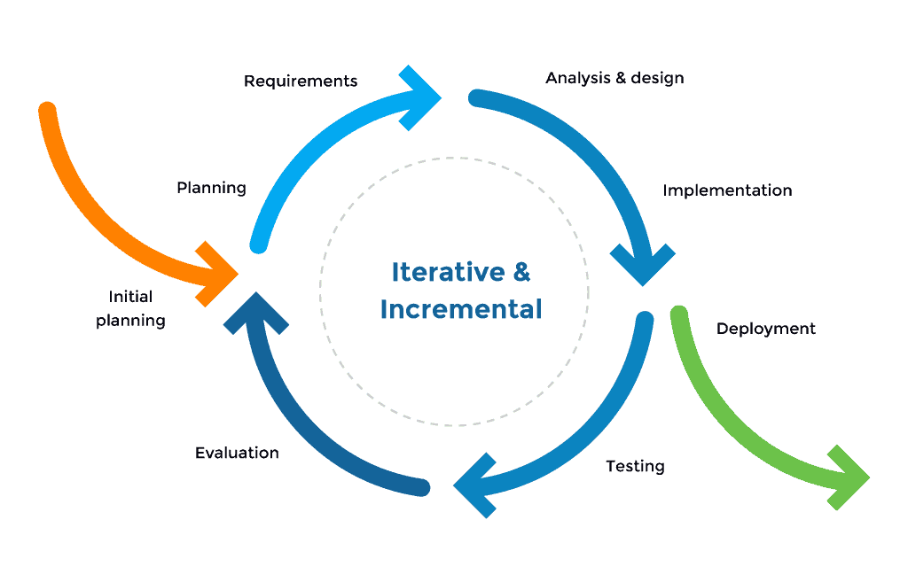
Agile SDLC Phases
Planning
Development
Testing
Deployment
Review.
Notes:
Let's explore how Agile redefines the SDLC. We move away from linear phases to an iterative approach. Each sprint becomes a mini-SDLC, with planning, development, testing, deployment, and reviews happening in parallel. This allows us to deliver working software faster, get feedback earlier, and make adjustments along the way.

Slide 4
Waterfall vs. Agile
Waterfall
Agile
Linear
Rigid
Fixed Requirements
Limited Customer Involvement
Testing at End
Single, Large Delivery
Iterative
Flexible
Evolving Requirements
Frequent Feedback
Testing Throughout
Incremental Deliveries Throughout
Notes:
This slide contrasts the Waterfall and Agile methodologies, emphasizing the advantages of Agile in dynamic environments. Waterfall is a traditional, linear approach, while Agile is iterative and adaptable. In Agile, we embrace change, while Waterfall aims to minimize it.
The starkest contrast, as we can see here, is waterfall is a linear process, and is hard to change once begun. Agile is iterative and is built to change. As we can also see here, a change request in waterfall would require the process to begin again, and in agile the change request would be added to the product backlog.
Our SNHU Travel project benefited greatly from Agile's flexibility.
Imagine a client requests a major UI change midway through the development phase. In Waterfall, this would likely require restarting the design and implementation phases, causing significant delays and cost overruns. In Agile, the change request would be added to the product backlog, prioritized, and incorporated into a future sprint.
The team would collaborate with the client to refine the requirements and implement the change incrementally.

Slide 5
Choosing a Methodology
Project Complexity
Requirements
Stability
Customer Involvement
Team Experience
Project Size
Risk Tolerance
Time Constraints
Regulatory Compliance
Company Culture
Notes:
This slide provides guidance on selecting the appropriate methodology based on project characteristics. Waterfall is best for projects with stable requirements, and agile is best for projects with dynamic requirements. The SNHU travel project was best suited for agile, due to its dynamic requirements, but it is best to assume not every project would be as suited. Choosing the right methodology is crucial for project success. Agile is ideal for projects with evolving requirements and a need for rapid feedback, however, Waterfall is ideal for projects with more static requirements and standardized measurements for success.
Our experience with the SNHU Travel project validated the benefits of Agile, in this instance, and shows that this methodology is powerful for projects such as these.

Slide 6
Resources
Schwaber, K., & Sutherland, J. (2020). The Scrum Guide. Scrum Guides. https://scrumguides.org/
What is Scrum? (n.d.). Scrum.org. https://www.scrum.org/learning-series/what-is-scrum/
Uttam. (2022, March 4). SDLC (Software Development Life Cycle) Phases, Process, Models - Complete guide - scmGalaxy. scmGalaxy. https://www.scmgalaxy.com/tutorials/sdlc-software-development-life-cycle-phases-process-models-complete-guide/
Steegh, R., De Voorde, K., Paauwe, J., & Peeters, T. (2024). The agile way of working and team adaptive performance: A goal-setting perspective. Journal of Business Research, 189, 115163. https://doi.org/10.1016/j.jbusres.2024.115163
USWDS: The United States Web Design System. (n.d.). U.S. Web Design System (USWDS). https://designsystem.digital.gov/

